Slide 1
Fake news detection in Deep Learning
Group 1

Slide 2
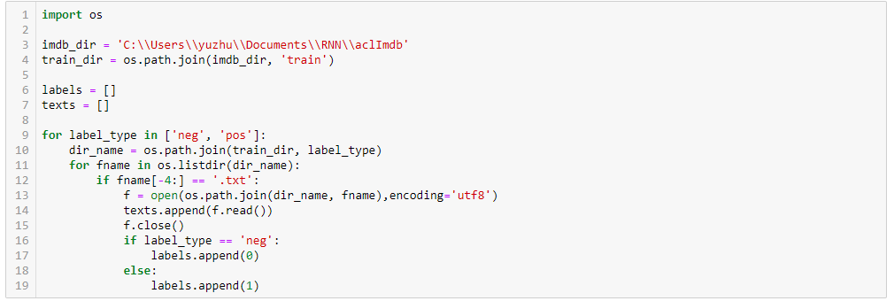
Input data

Slide 3
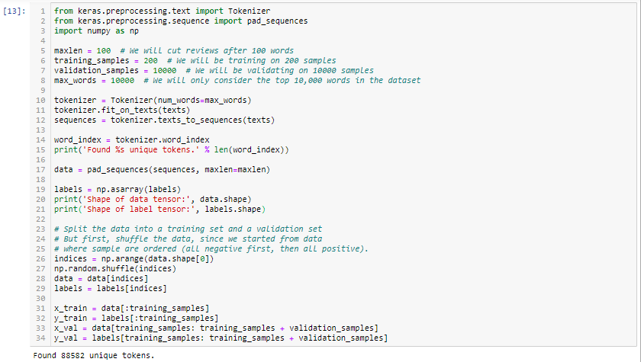
Tokenized the text

Slide 4
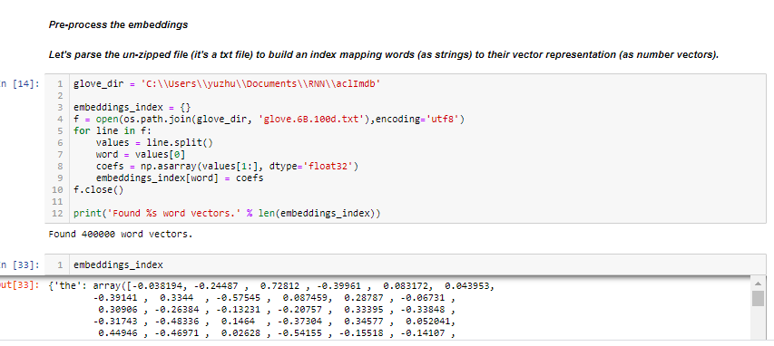

Slide 5
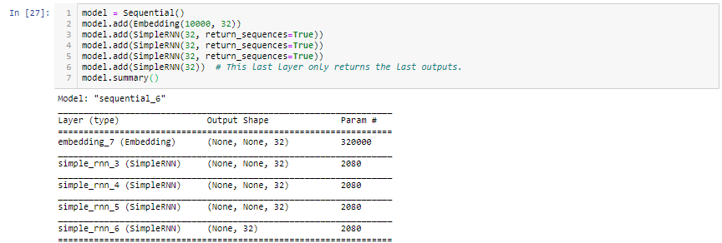
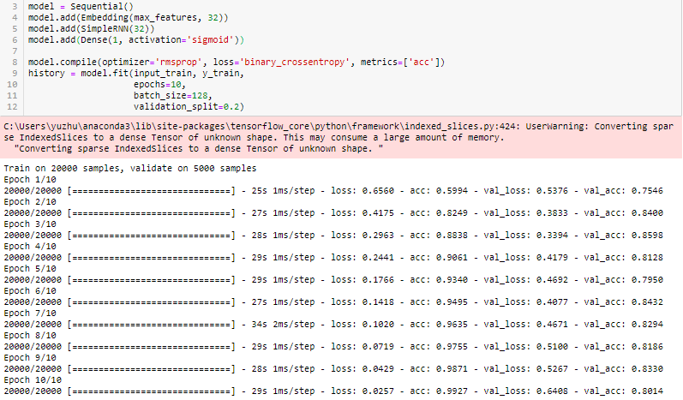
Simple RNN

Slide 6
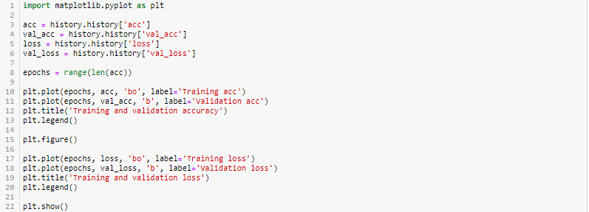
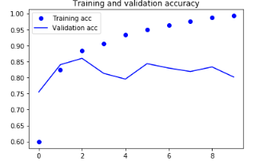
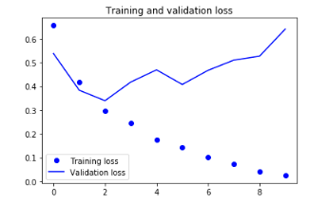

Slide 7
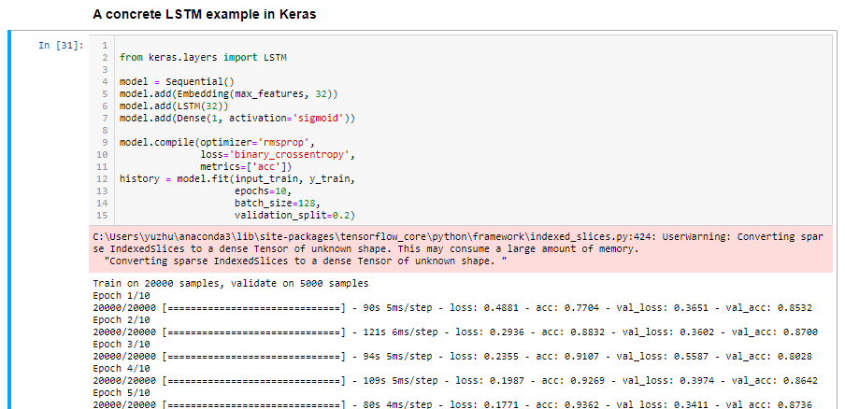
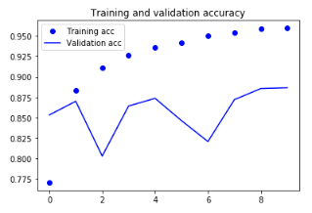
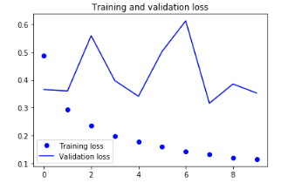

Slide 8
Next step
consider the result is not that good for now, we are also thinking of apply lemmatization
Recurrent dropout -fighting the overfitting
Stacking recurrent layers - increases the representational power of the network
Bidirectional recurrent layers - These present the sample information to a recurrent network in different ways, increasing accuracy and mitigating forgetting issues

